Slide 1

Nerdies: Droids and drones
Pictorial Tutorial
Friday July 18, 2014

Slide 2
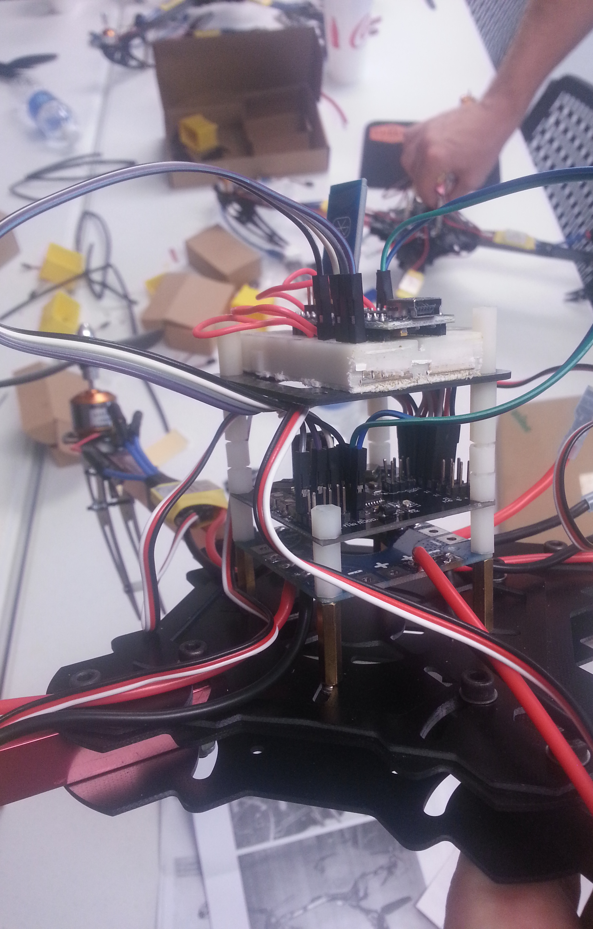
Electronics Stack
Arduino & Bluetooth Module
Flight Controller
Power Distribution

Slide 3
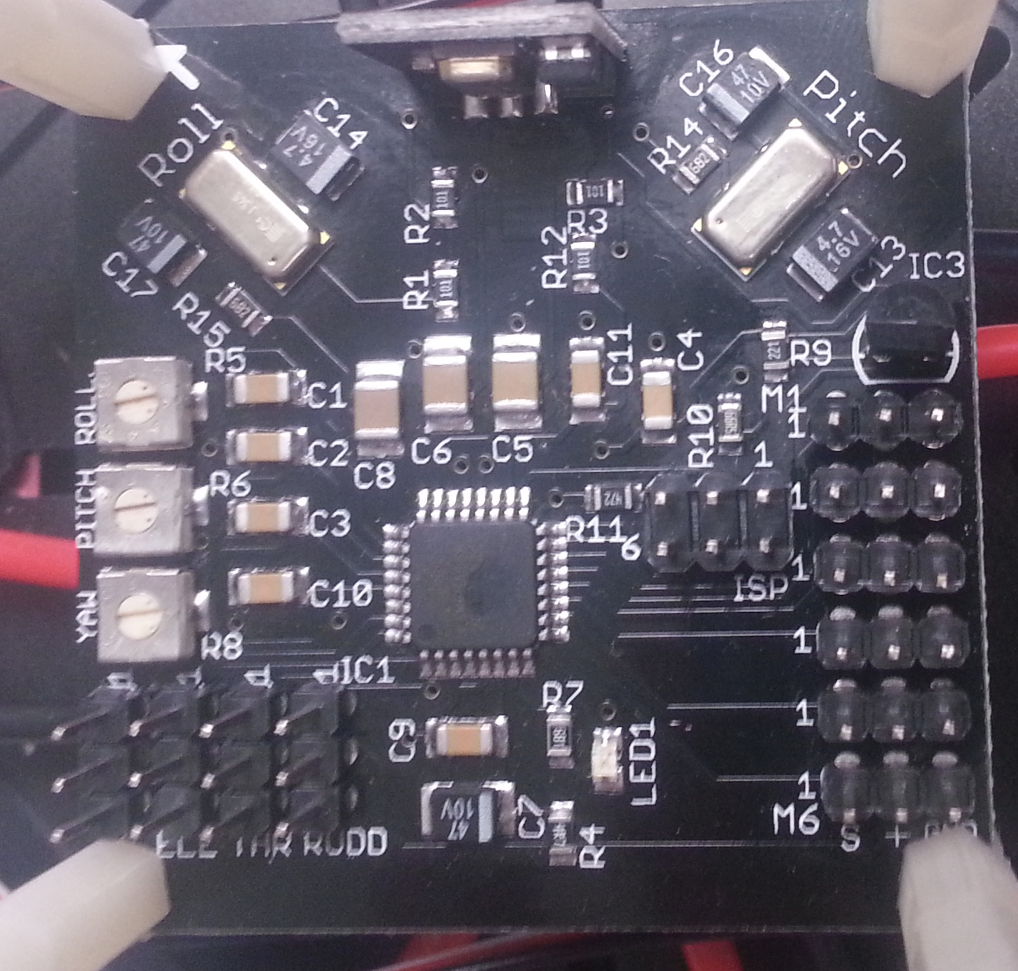
Flight Controller
This is the KK flight controller
Flash the KK board by placing the USBasp header pins on the the area highlighted by the brown box. See the “Instructions for Flight” document and next page for further instructions on flashing this board.

Slide 4
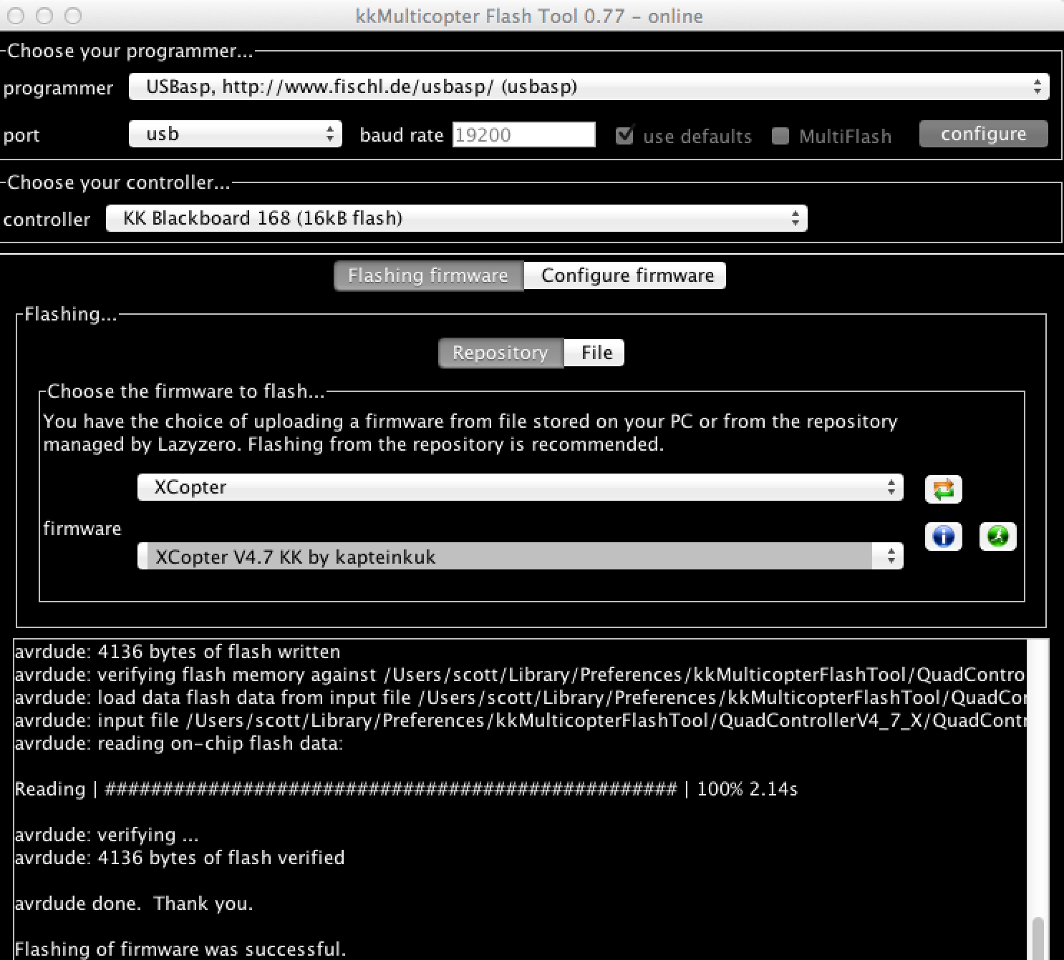
KK Board Flashing
Settings for flashing should be set as shown in the diagram on the right.
See the “Instructions for Flight” document for further instructions on flashing this board.

Slide 5
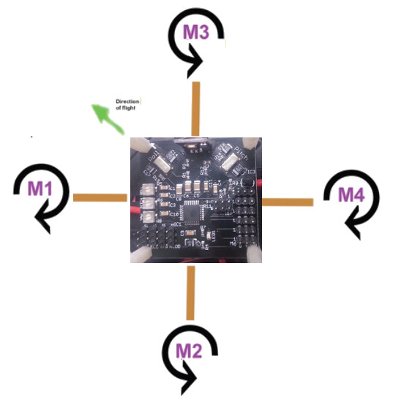
Motor & Propeller Orientations
Make sure to put your propellers on with the angle of attack leading towards the proper rotation, clockwise or counter-clockwise

Slide 6
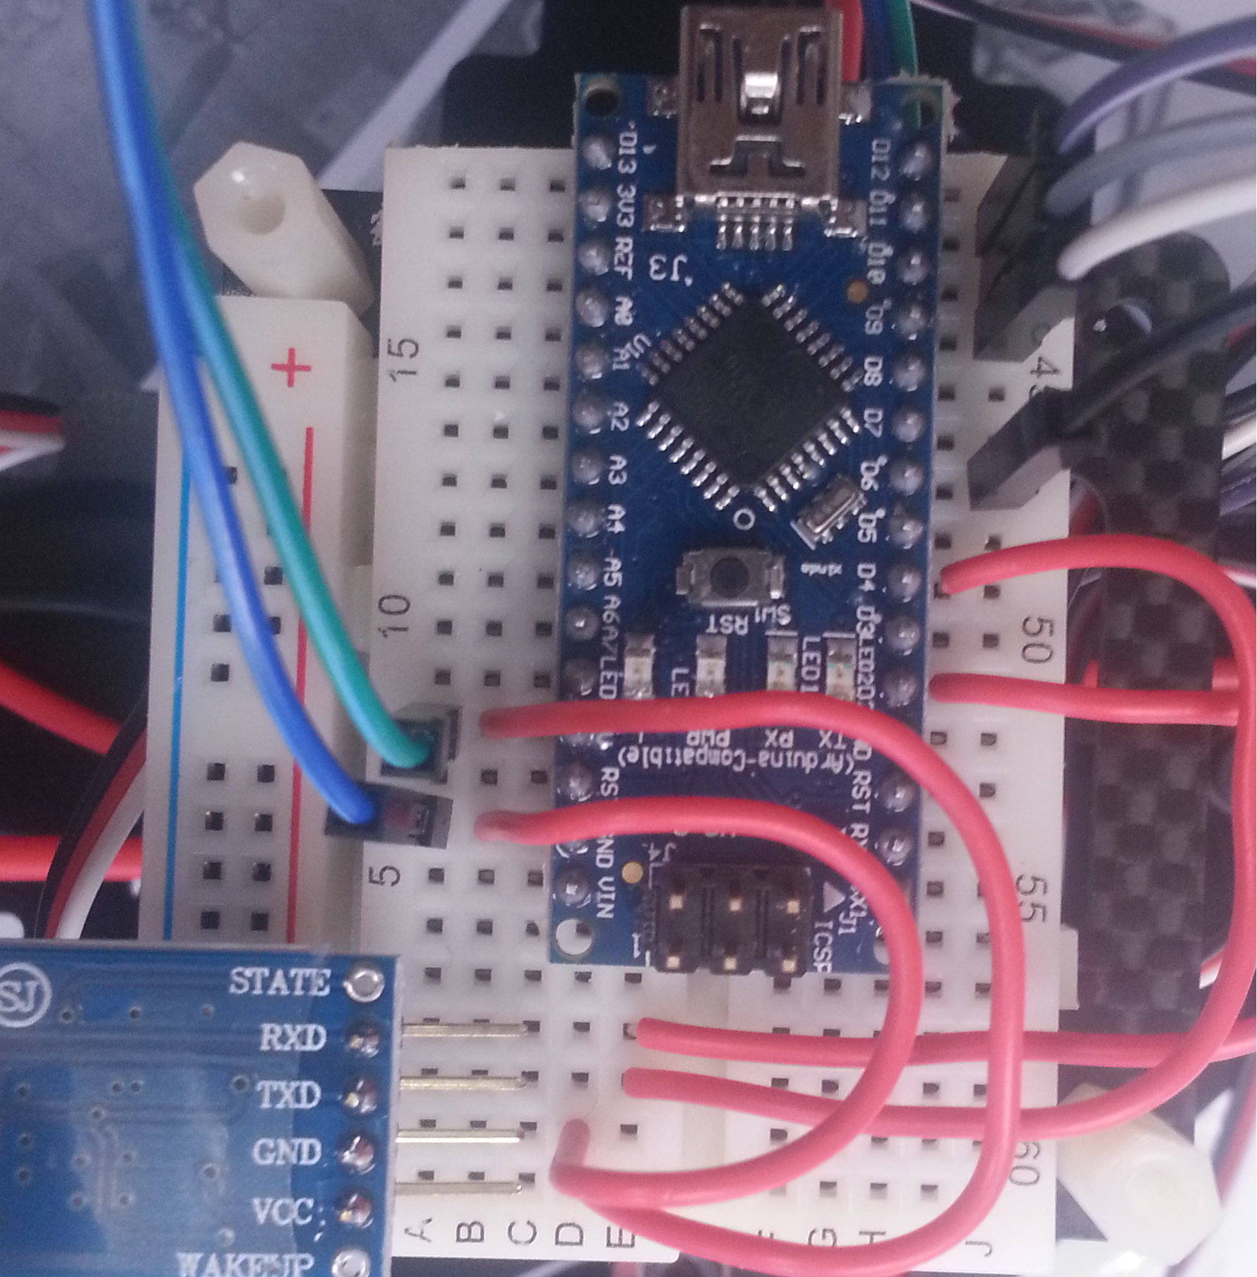
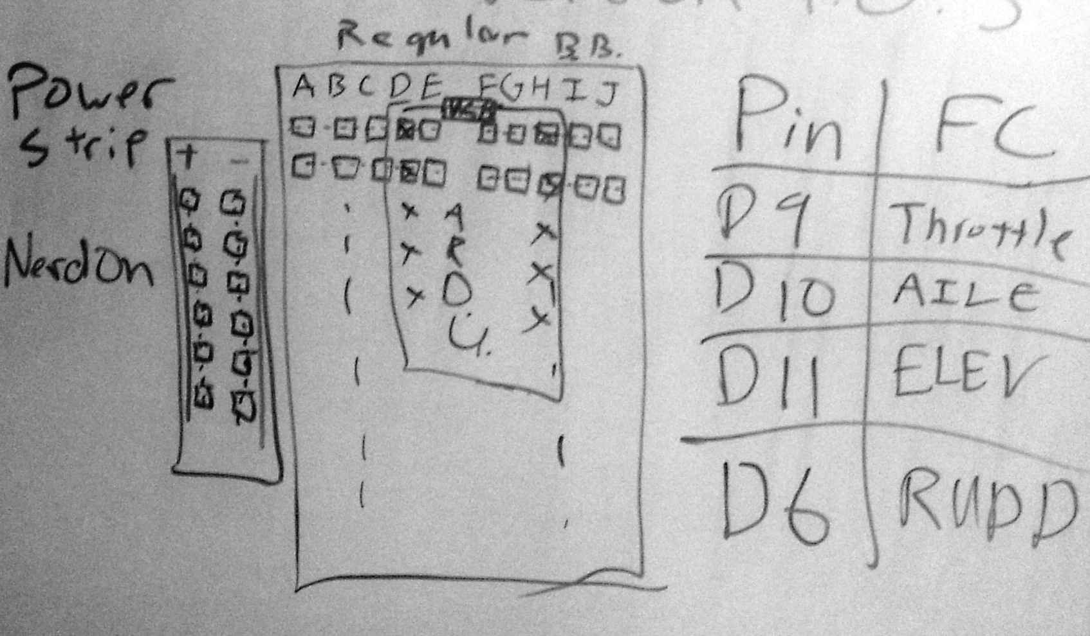
Arduino & Bluetooth Breadboard Connections
Tx of the bluetooth module is connected to pin D4 and Rx is connected to pin D2.
A 5V jumper cable (Green in the diagram) is attached to a 5V pin on the KK board (the AILE 5V pin or other input pin 5V is a good choice). Likewise a GND cable (blue) is attached. Attach the remaining pins as the below diagram describes.

